Slide 1

An Introduction to PyTorch
UPE Lunch & Learn
Presented by N’yoma Diamond

Slide 2
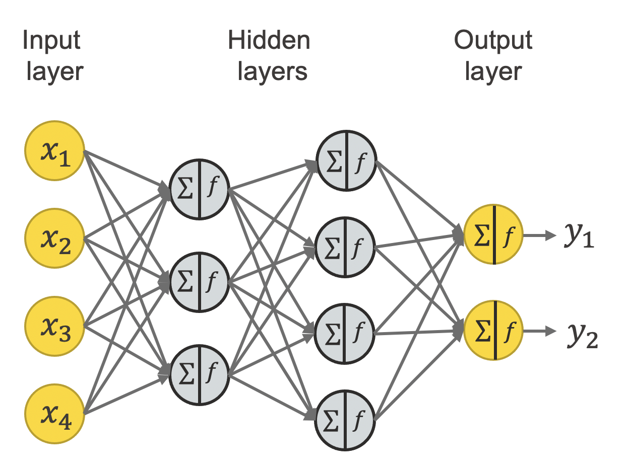
Neural Networks: A Crash Course
Networks

Slide 3
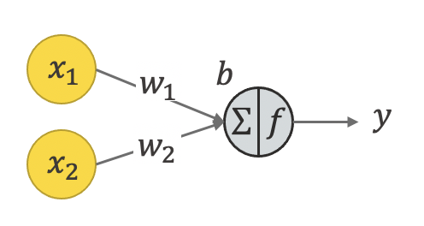
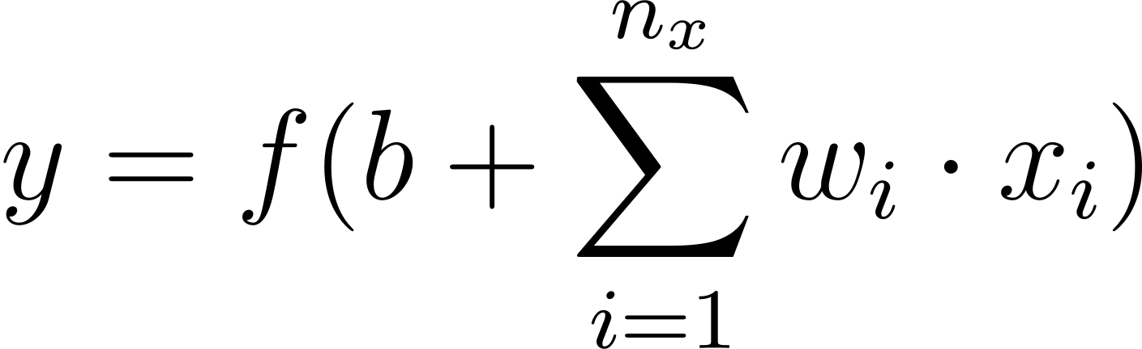
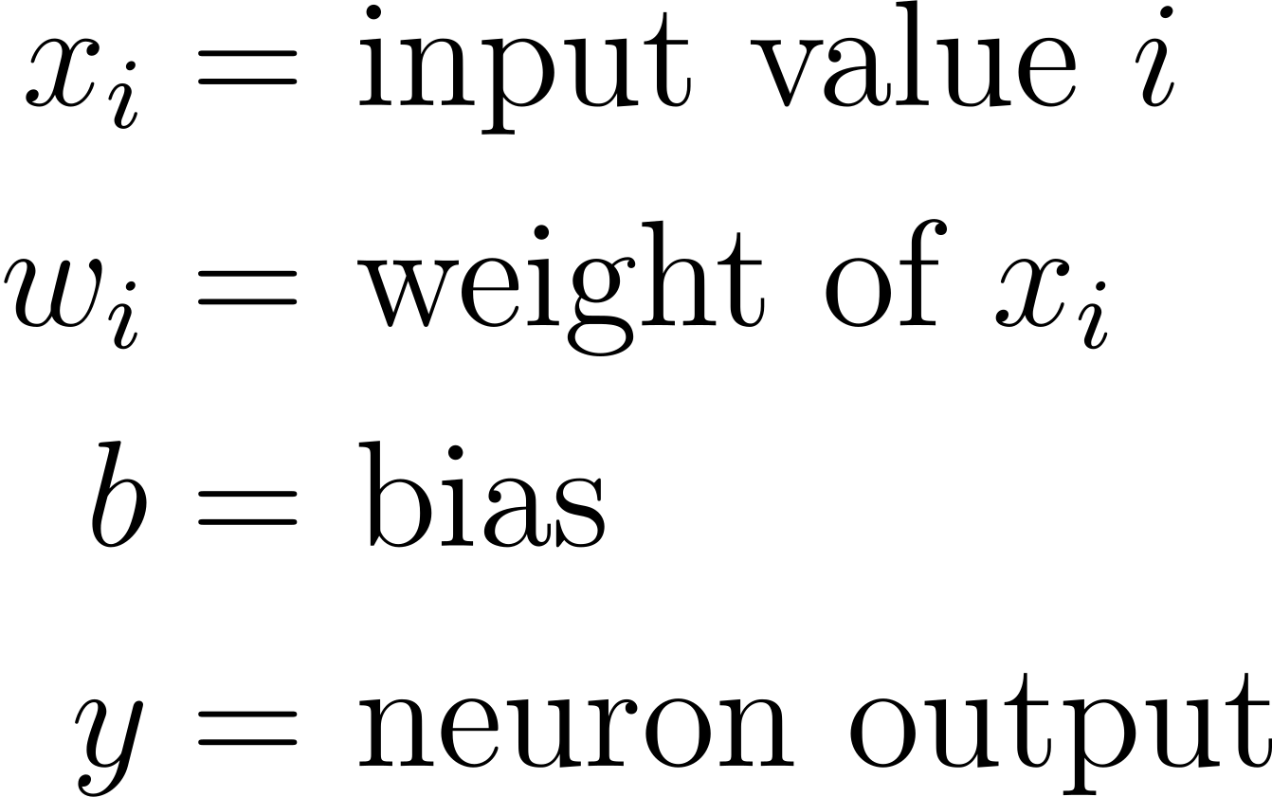
Neural Networks: A Crash Course
Neurons

Slide 4
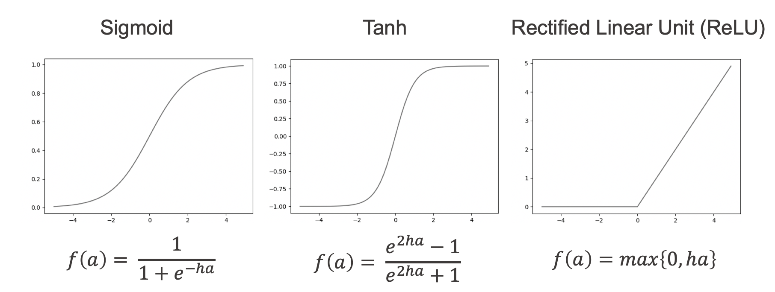
Neural Networks: A Crash Course
Activation Functions

Slide 5
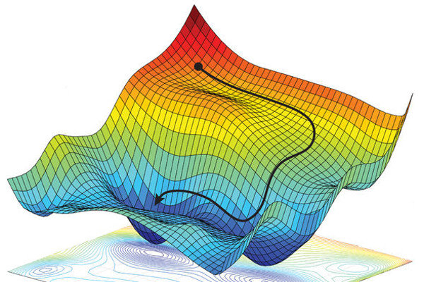
Neural Networks: A Crash Course
Optimization (Training)

Slide 6
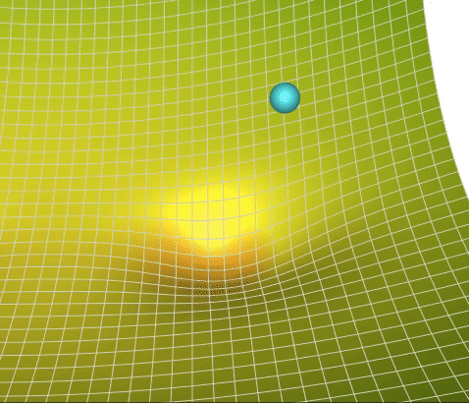
Neural Networks: A Crash Course
Optimization (Training)

Slide 7



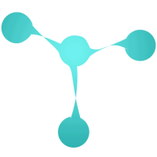
: What is it?

Slide 8
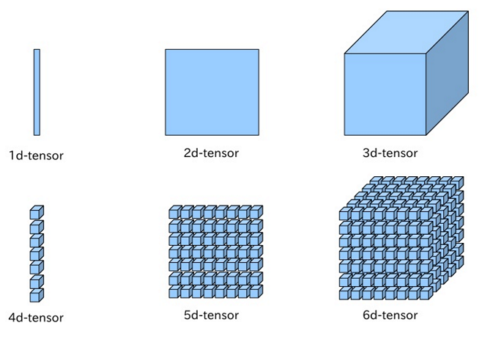
: What is it?
Tensors

Slide 9
References
https://www.knime.com/blog/a-friendly-introduction-to-deep-neural-networks
https://www.researchgate.net/publication/325142728_Spatial_Uncertainty_Sampling_for_End-to-End_Control
https://towardsdatascience.com/a-visual-explanation-of-gradient-descent-methods-momentum-adagrad-rmsprop-adam-f898b102325c
https://medium.com/@anoorasfatima/10-most-common-maths-operation-with-pytorchs-tensor-70a491d8cafd
https://pytorch.org/

